Slide 1



Emotion Detection
Presented by: Tina Gholami
MESc, Software Engineering
25 November, 2020
Supervisor: Prof. Katarina Grolinger
University of Western ontario
1

Slide 2

Introduction
Webcam Streaming
01
03
CNN Model
Results
02
04
Past works
Present work
Future works
Image processing
CNN version 1
CNN version 2
Accuracy
Comparison
Impediments
2

Slide 3
Introduction
01
3

Slide 4


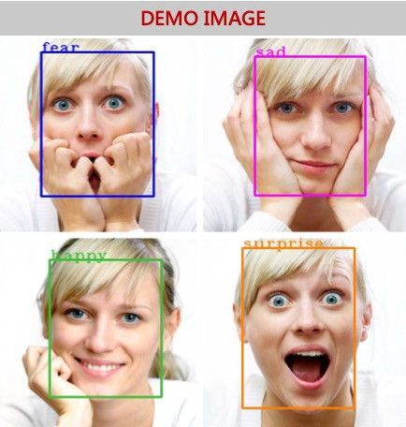

Can we detect feelings?
Past works:
Images
CNN model
Present work:
Streaming data
Future works:
Crime Detection
4

Slide 5
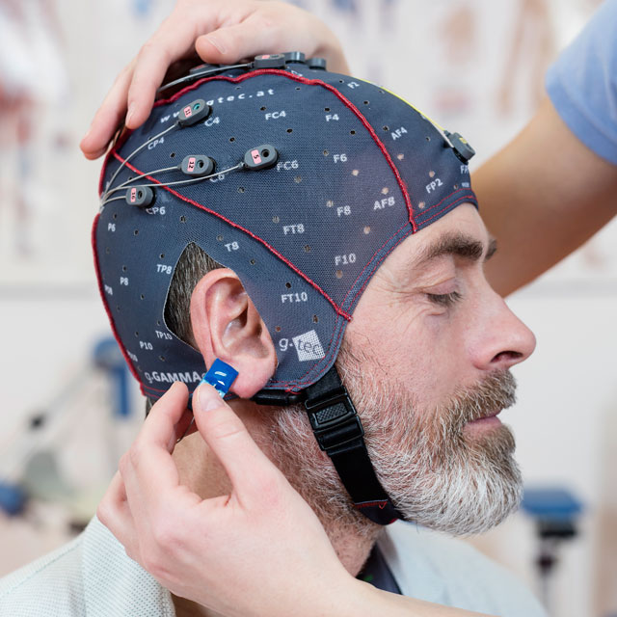
Feeling Detection by EEG Signals
EEG caps
Sensors
Machine learning model
Train the model
EEG signal processing
Matlab and Python
5
Big Data

Slide 6
CNN Model
02
6

Slide 7
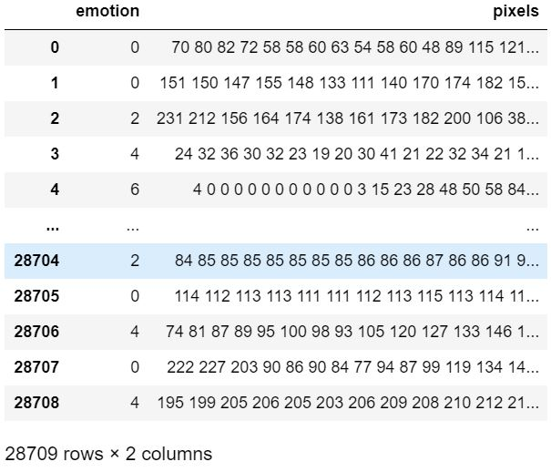
The Dataset
Kaggle’s Facial Expression Recognition Challenge dataset
48x48 gray scale images of faces
Categorize each face based on the emotion
Labels: 0 = Angry, 1 = Disgust, 2 = Fear, 3 = Happy, 4 = Sad, 5 = Surprise, 6 = Neutral
28,709 images -> High Volume -> GPU
7

Slide 8
Data Preparation
Data Preparation:
Hold-out method to split the data into test set and train set
Validation data
Standardization: Feature scaling
Reshape -> for the CNN model
8

Slide 9

CNN Architecture
Version 1 | Version 2
Convolution layer: 32 Convolution layer: 64 Max pooling: (2, 2) Convolution layer: 128 Drop out: 0.1 Max pooling: (2,2) Flatten Dense: 2048 Drop out: 0.5 Dense: 1024 Drop out: 0.5 Dense: 512 Drop out: 0.5 Softmax: 7 | Convolution layer: 128 Max pooling: (2, 2) Drop out: 0.1 Convolution layer: 128 Max pooling: (2, 2) Drop out: 0.1 Convolution layer: 256 Max pooling: (2, 2) Drop out: 0.1 Flatten Dense: 500 Drop out: 0.5 Dense: 200 Drop out: 0.4 Dense: 100 Drop out: 0.3 Softmax: 7
Using different kernel size for the layers
Employing Early Stopping
Saving model and weights in json formt
9

Slide 10
Webcam Streaming
03
10

Slide 11

Image Processing
Steps:
Importing CNN model and weights from .json files
Importing Face detector file
Reading from the webcam data for each frame
Changing to gray scale
Preparing the frames to be fed into the CNN model
Labeling the emotion tags on the detected face frame
11

Slide 12
Results
04
12

Slide 13
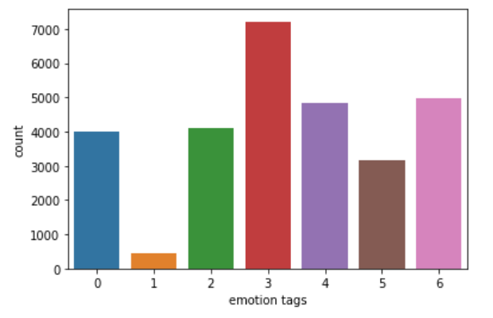
Performance Evaluation
 | Accuracy | Precision | F1 Score
Test Data Model 1 | 54% | 61% | 50%
Recall
48%
Test Data Model 2 | 56% | 59% | 50%
48%
13

Slide 14
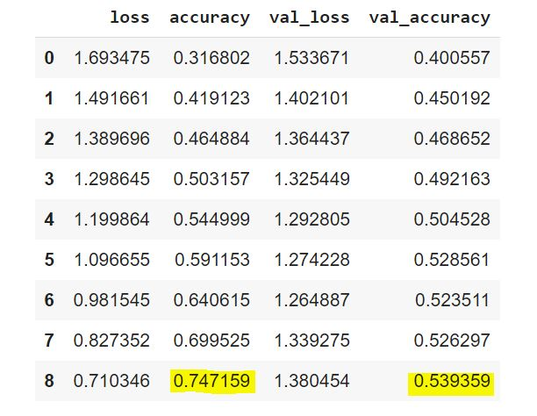
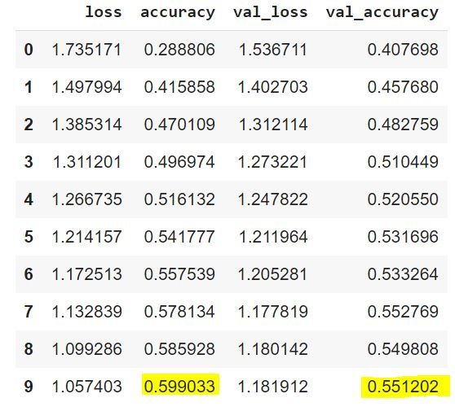
Performance Evaluation
Model 1 performance:
Model 2 performance:
14

Slide 15
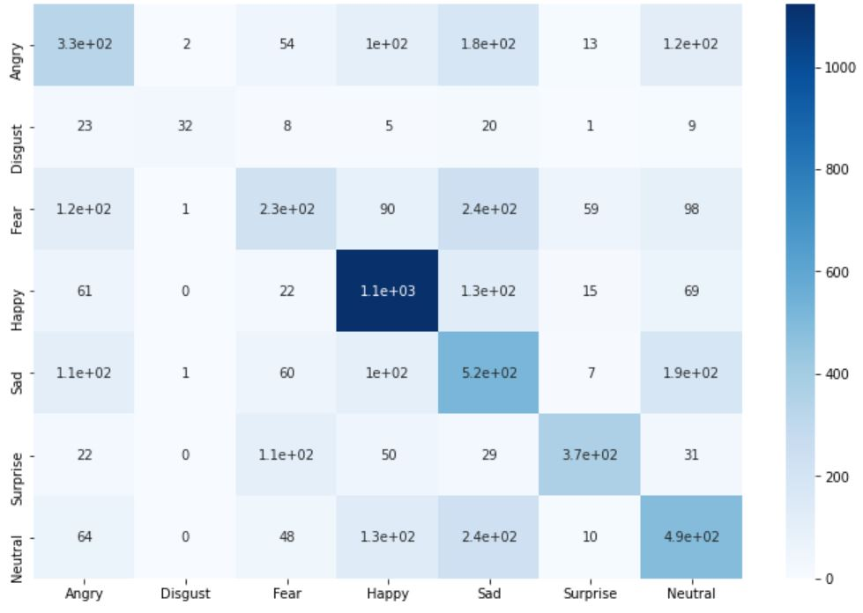
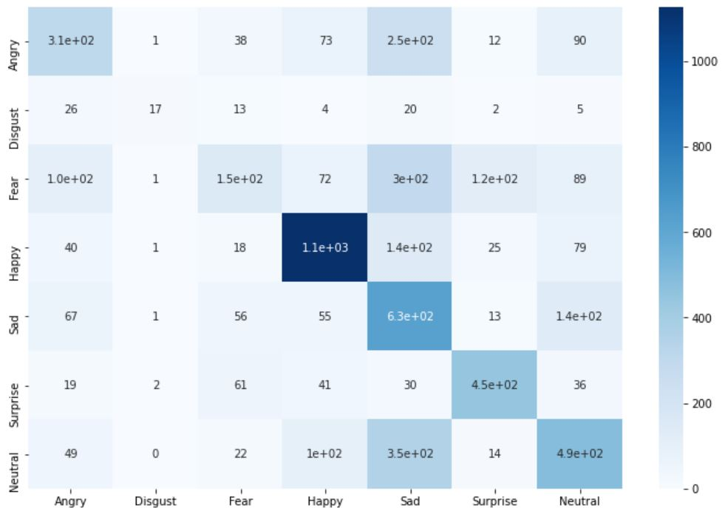
Heat maps
Model 1 performance:
Model 2 performance:
15

Slide 16
Model Comparison
Accuracy
Accuracy
Nearly 75% on the train set
Nearly 54% on the test set
Nearly 60% on the train set
Nearly 55% on the test set
1
2
Model Structure
Model Structure
Less complex CNN
More complex ANN
1
2
More complex CNN
Less complex ANN
CNN >> ANN
16

Slide 17
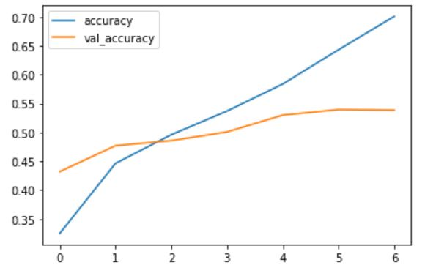
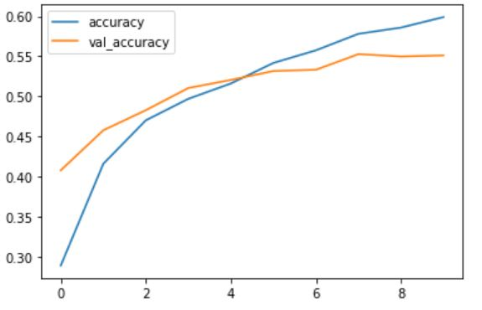
Model Comparison
Model 1 Accuracy:
Model 2 Accuracy:
17

Slide 18
Parametre Tunning
Rectified linear unit
Tangent hyperbolic
25
35
Activation Functions
Epochs
Best Accuracy: 56%
Best Precision: 59%
Epochs: 25
Neurons: 32***
Optimizer: Adam
Activation Function:
“Relu”
Neurons
Optimizers
32
64
Adam
Stochastic gradient descent
18

Slide 19
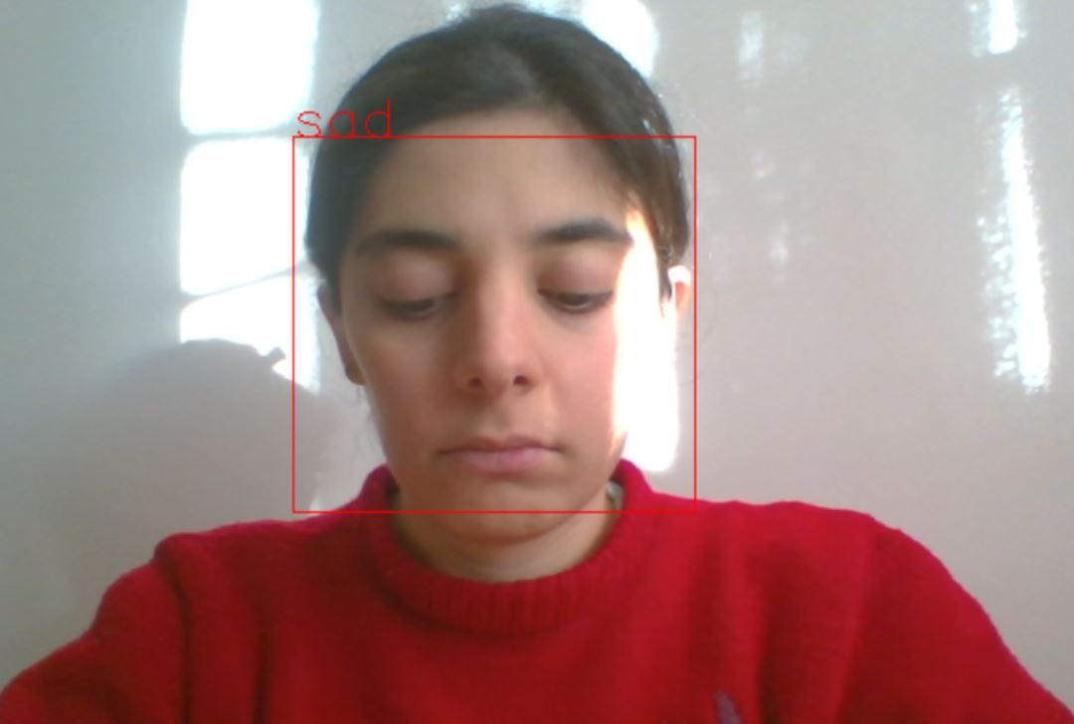
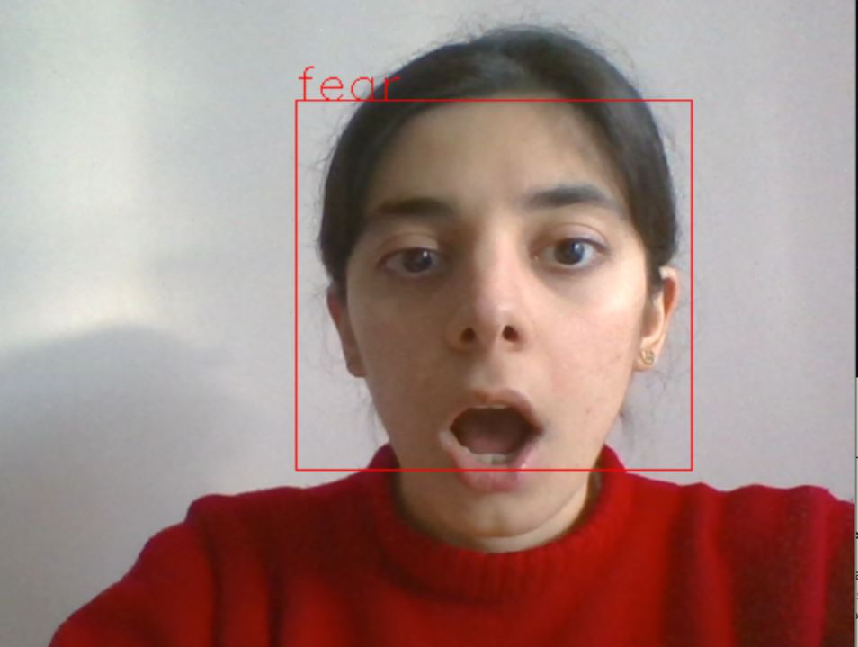
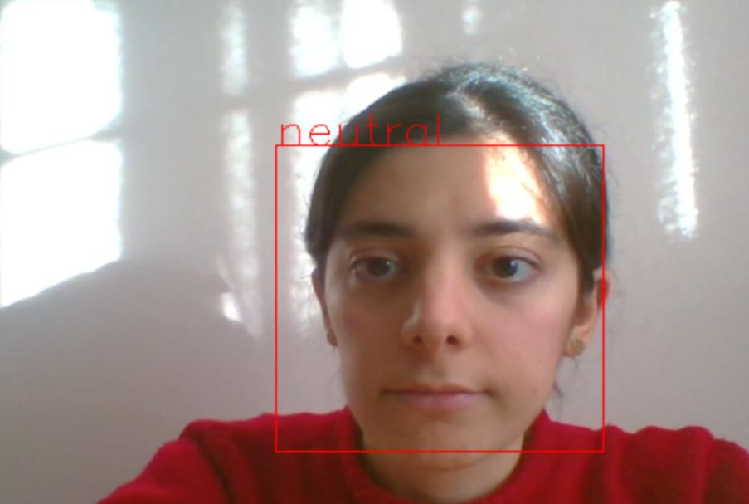
Webcam Results
Neutral
Sad
Fear
19

Slide 20

Impediments
Real time streaming
More data
Greater error
Lower accuracy
Image VS Stream Video
Low Accuracy
Imbalance class: “Disgust” VS “Happy”
Model architecture
Input data
Ethical? Fair?
Privacy
Crimial activity and lie detectors
Sybil system?
AI Ethics
20

Slide 21
Suggestions
Other quicker model
Sharper processing units
Parametre tunning!
Ensemble methods
XGBoost, CatBoost
GPUs
Super computers
Higher quality images
Diverse input data
Train a better model
Better imaging devices
Costly
Various age groups
Adding rotation, tilting, etc. to the data
21

Slide 22
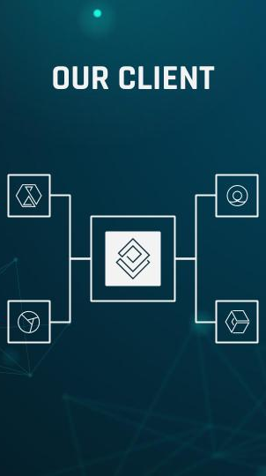
Hopfully…
Analyzing the bio signals (face expression, voice, eye movement, etc.) to detect feelings and criminal intentions much more accurately using everyday devices!
22

Slide 23

Thank You!
Do you have any questions?
tgholam2@uwo.ca
University of Western Ontario
23

